Slide 1
Welcome to my presentation
Name: Md Selim Daptari
Batch- 46
Roll - 04
Topic: Stock Management data on Excel

Slide 2
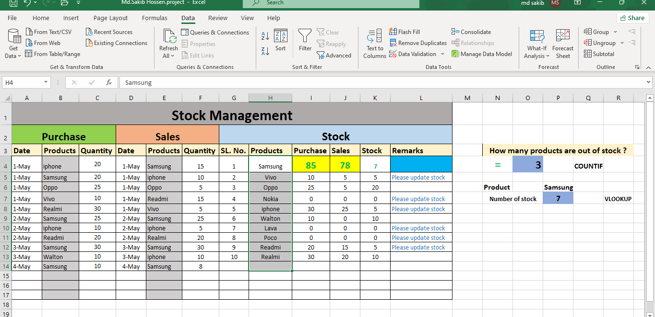
Stock Management

Slide 3
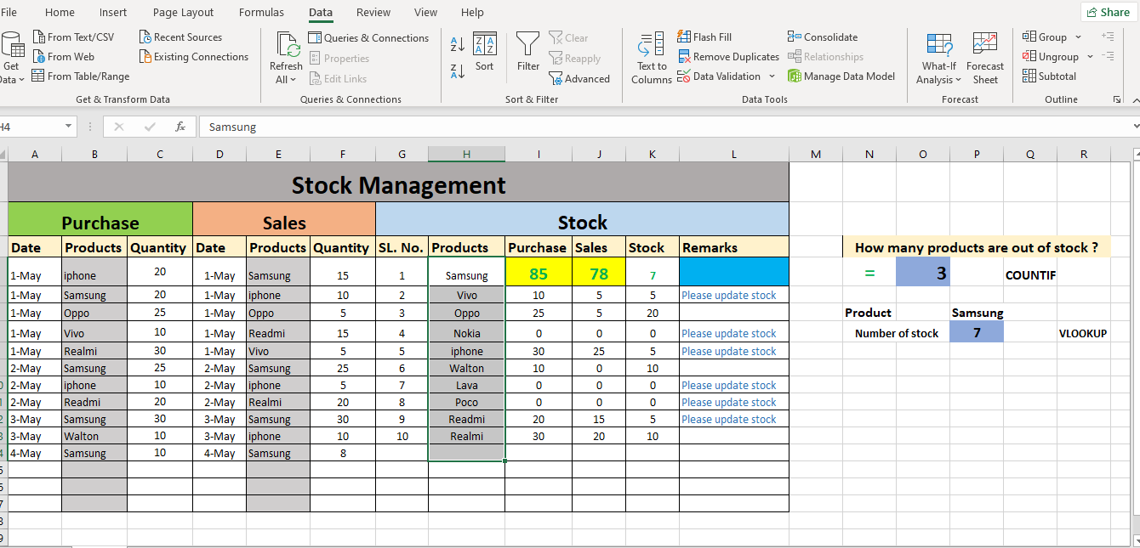
Data validation

Slide 4
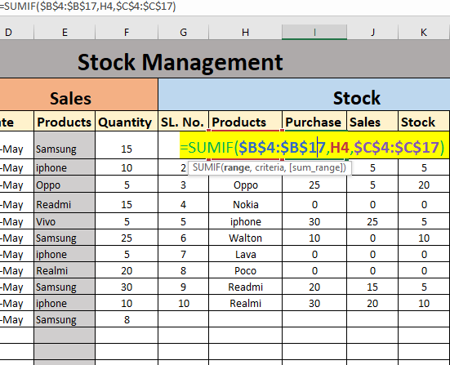
Sum if formula

Slide 5
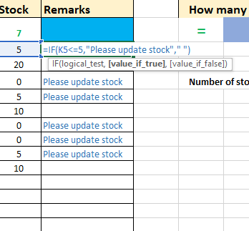
If Formula

Slide 6
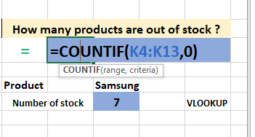
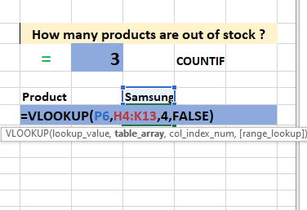
Count if formula
Vlookup formula

Slide 7
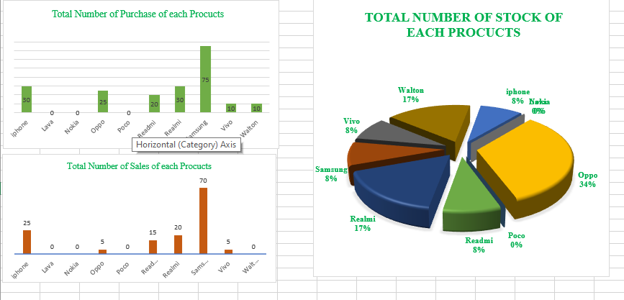
Graph Chart

Slide 8
Thank you

